Slide 1
Music Genre Classification based on lyrics
Daivik U D : 01FB15ECS085
Saudamini Khare : 01FB15ECS270
Sushmitha Somashekar : 01FB15ECS319
UE15CS333 project submission

Slide 2
About the project
Project idea:
Classification of music is a very important and heavily researched task in the field of NLP. Previous research in this field has focused on classifying music based on mood, genre, annotations, and artist. All the approaches either used audio features, lyric as text or both in combination.
Genre classification by lyrics is itself a clear Natural Language Processing problem. The end goal of NLP is to extract some sort of meaning from text. For music genre classification, this equates to finding features to classify music using lyrics.
We have used Positive Naive Bayes Classifier to find all the possible genres for a particular song’s lyrics.

Slide 3
Literature survey and existing work
http://worldcomp-proceedings.com/proc/p2016/DMI8052.pdf
https://www.nltk.org/_modules/nltk/classify/positivenaivebayes.html
http://josh-jacobson.github.io/genre-classification/doc/paper.pdf
https://www.sciencedirect.com/science/article/pii/S1110866512000151

Slide 4
Dataset source and preprocessing done
Dataset source: Since the data available was inconsistent we ran a python script to scrape the data of lyrics of songs from 1970-2015.
Pre-processing steps performed: First we extracted the names of the songs and the artist and then later map the lyrics along with the genre All this information is first saved in a json and then write the structured data into a csv

Slide 5
High level design of our implementation
Building the Training Sets
For each genre, there is an in-genre set and all other genres together are not-in. We trained the model and built fifteen classifiers.
Train
The parameter prior is manually set for each iteration of the training process. It is either a uniform prior of a selected level, or a genre-dependent prior obtained from the relative frequency of the genre's appearance.
Testing Set
This part takes a sentence from each song and submits it to each of the fifteen classifiers. For each, it compares the predicted result to the observed value, keeping track of true and false positives and negatives.
Genre Classification
The classifier will run against each genre and report which ones it considers a match. IF the matches are coming up empty, we can increase the sensitivity by de-commenting the line that runs the classifier training with a higher prior value. It is suggested that we do not use prior values which are higher than 0.5.

Slide 6
High level design of our implementation (2)
Why use Positive Naïve Bayes classifier?
The Naïve Bayes algorithm is perhaps the most popular classification model used in text mining applications.
A variant of the Naive Bayes Classifier that performs binary classification with partially-labelled training sets. In other words, assume we want to build a classifier that assigns each example to one of two complementary classes (e.g., male names and female names). If we have a training set with labelled examples for both classes, we can use a standard Naive Bayes Classifier. However, consider the case when we only have labelled examples for one of the classes, and other, unlabelled, examples. Then, assuming a prior distribution on the two labels, we can use the unlabelled set to estimate the frequencies of the various features.

Slide 7
Milestones
1) Scarping of data in order to get a consistent dataset
2) Coming up with a suitable model in order to predict the genres

Slide 8
Top Challenges unresolved so far
It predicts many genres so to boil down to one particular genre hasn’t been resolved

Slide 9
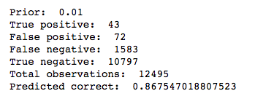
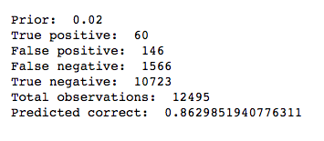
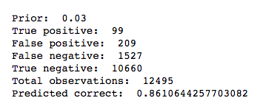
results, visualization, metric
The same metrics are recorded for prior = 0.05, 0.1, 0.2, 0.3, 0

Slide 10
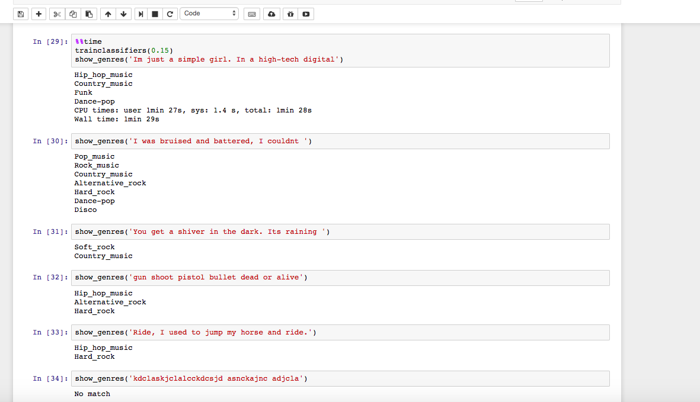
We can then put the lyrics of our choice and see which are the plausible genres for that song

Slide 11
Our top three learning in this project
Learning # 1 : Working and getting familiarised with NLTK and the Positive Naive Bayes Classifier
Learning # 2 : Working with pyquery package
Learning # 3 : Working with json files

